Slide 1

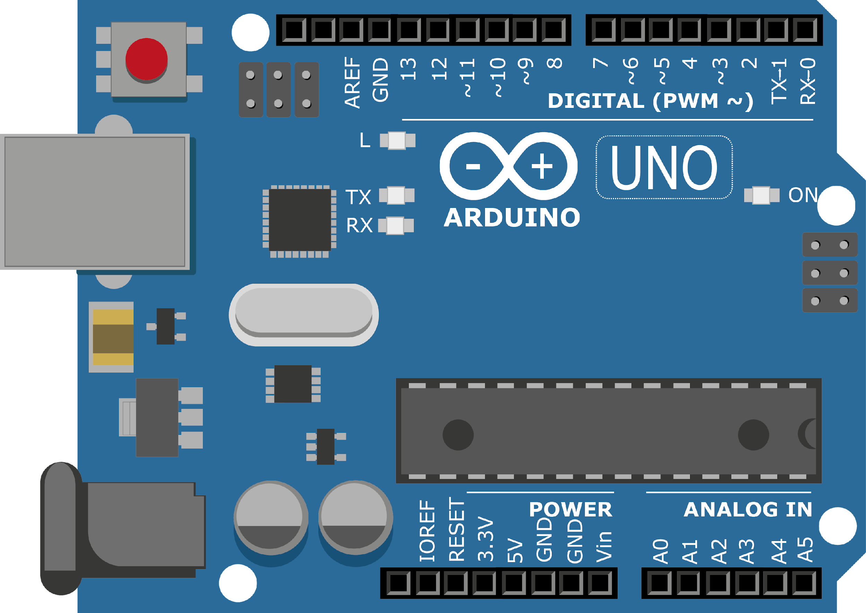
ARDUINO MASTER CLASS
13
Obstacle avoidance Robot

Slide 2
13 AGENDA
02
03
01
Obstacle avoidance robot
Ultrasonic
Q & A

Slide 3
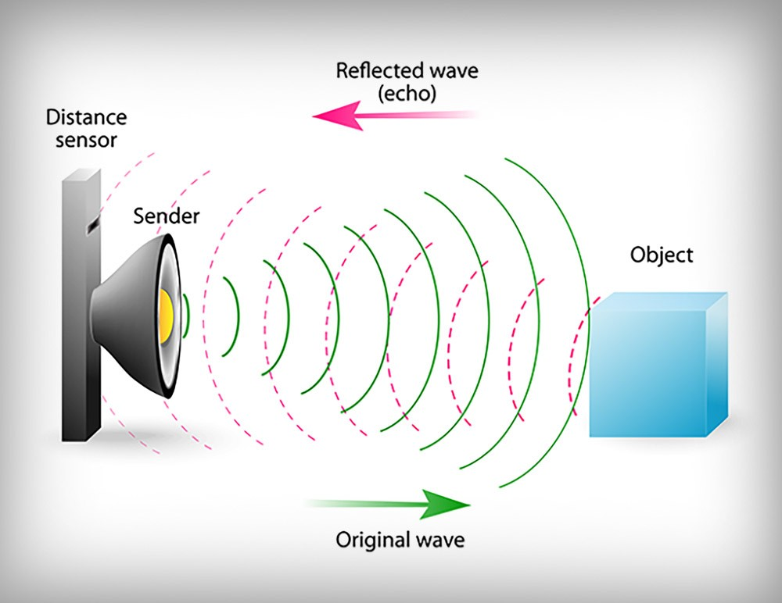
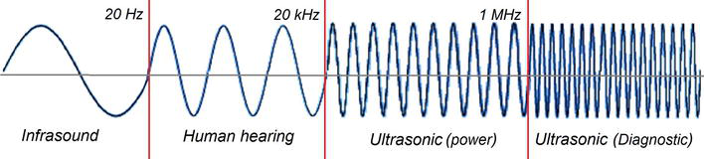
Ultrasound Technology
Ultrasound is sound waves with frequencies higher than the upper audible limit of human hearing. Ultrasound is not different from "normal" sound in its physical properties, except that humans cannot hear it.

Slide 4
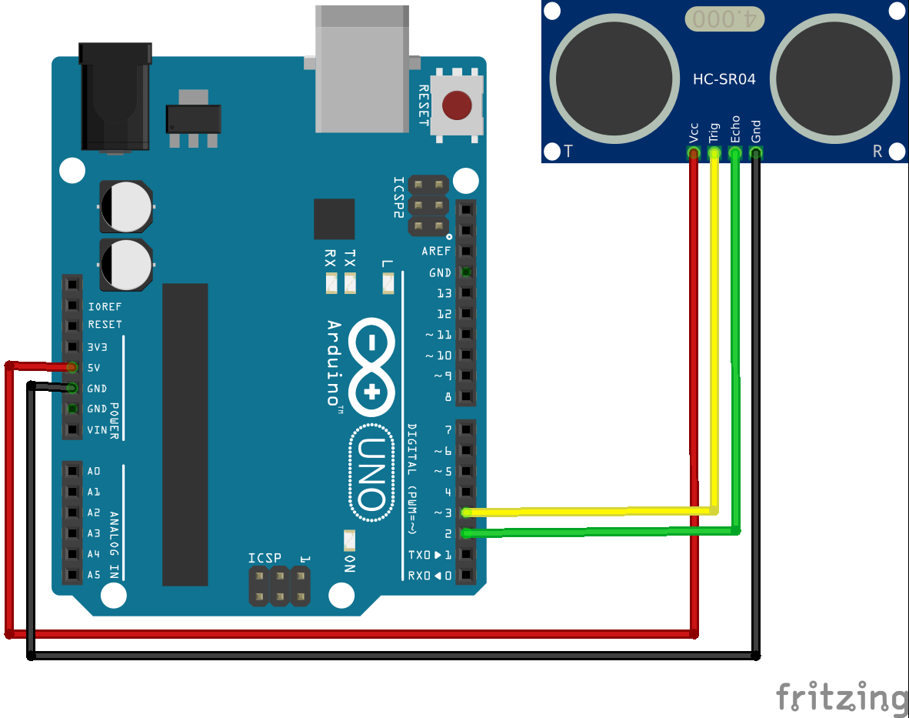
Ultrasonic with Arduino

Slide 5
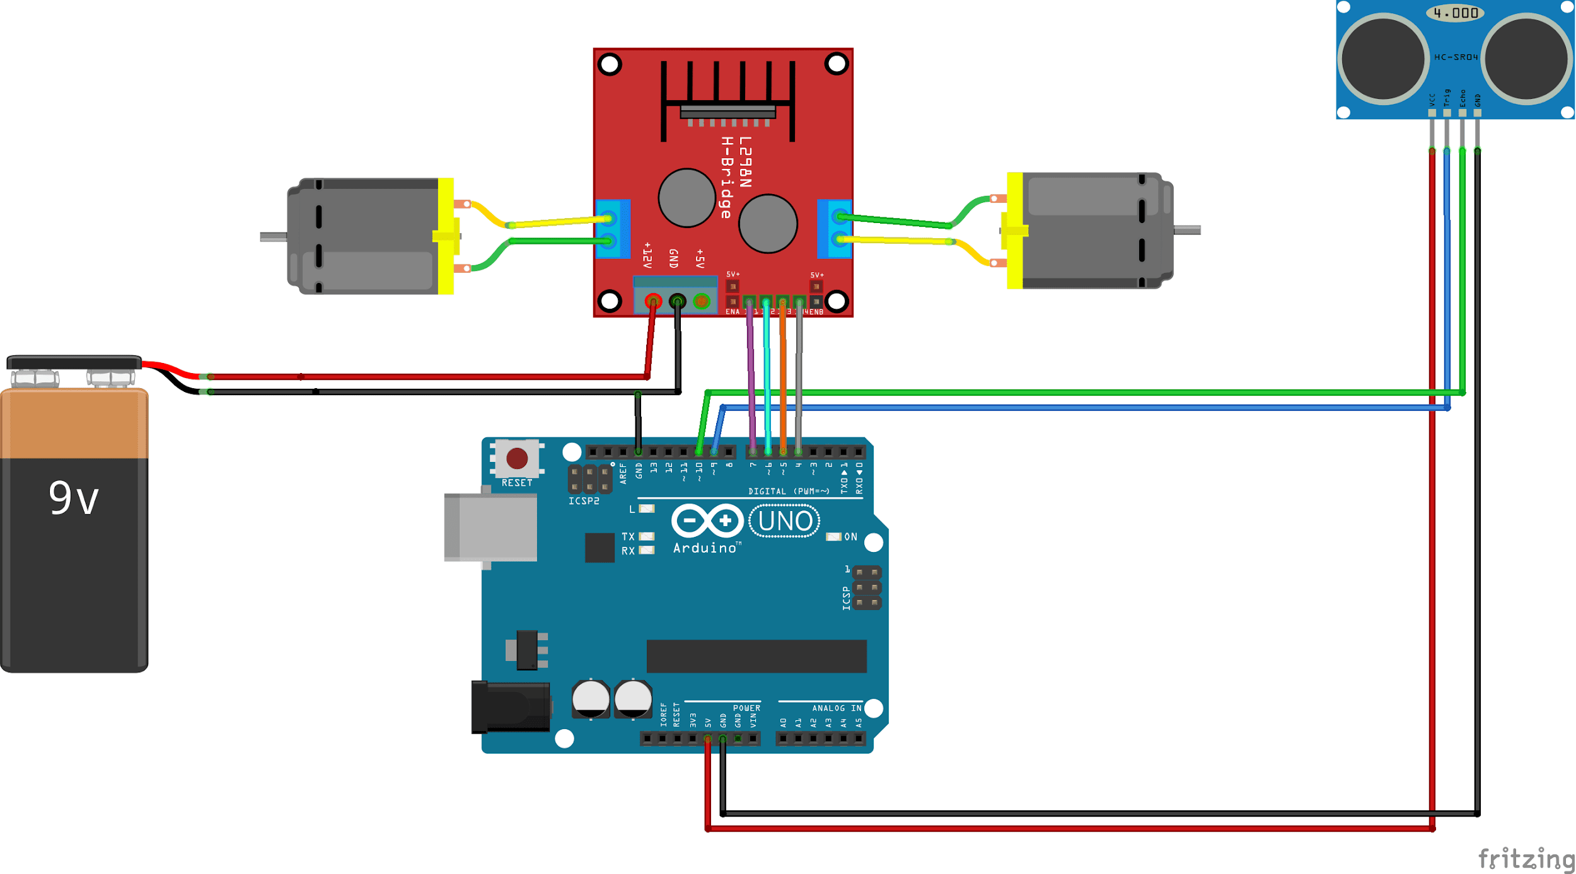
Obstacle avoidance Robot

Slide 6
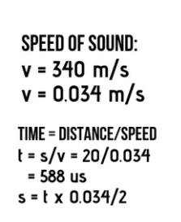

INTERVIEW QUESTIONS
Name the modulation techniques.
What is sampling?
Ultrasonic Formula
For Analog modulation--AM, SSB, FM, PM and SM
Digital modulation--OOK, FSK, ASK, Psk, QAM, MSK, CPM, PPM, TCM, OFDM
The process of obtaining a set of samples from a continuous function of time x(t) is referred to as sampling.

Slide 7

THANKS!

